Slide 1
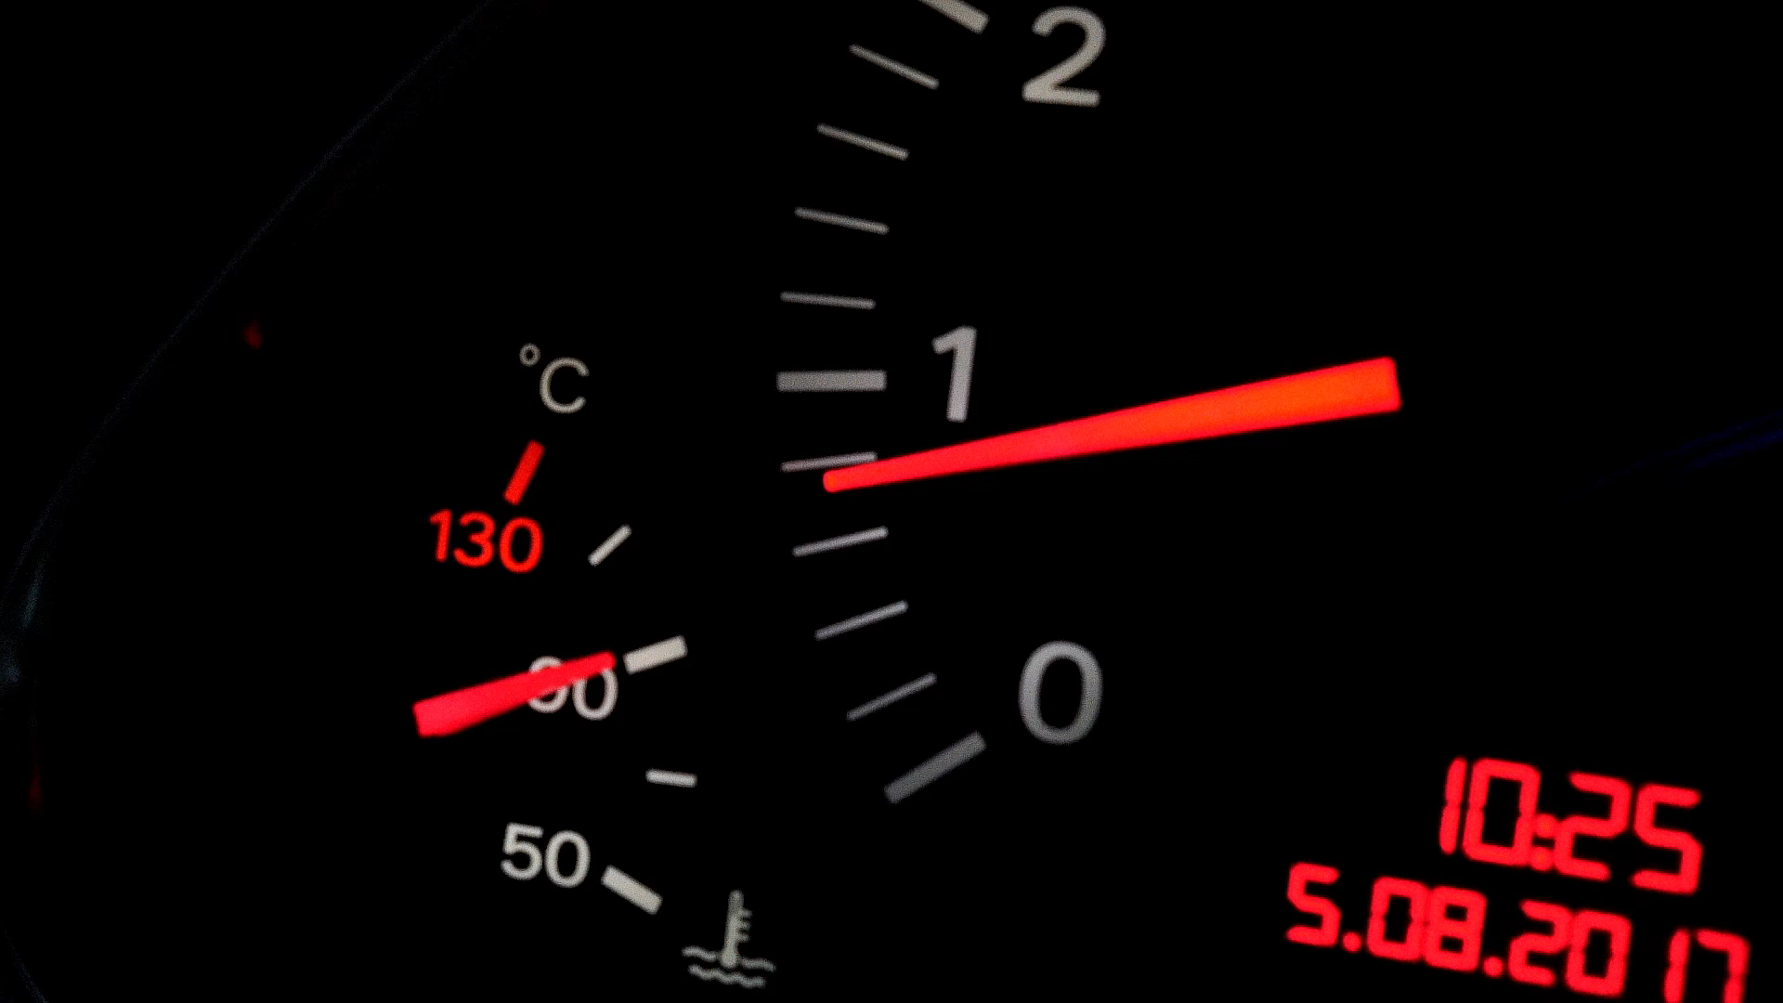
Motor Insurance Part Mapping and Recommendation
Ctrl Alt Del DecodeX

Slide 2
OVERVIEW
Introduction
Key Risks
Data Description
Data Analysis
Data Cleaning
UI Integration
Conclusion
Proposed Approach
Business Problem

Slide 3
introduction
Background:
AutoSure Insurance is a leading company in motor insurance claims.
Despite an efficient claim process, inconsistencies arise in damage assessment.
Claim Process Overview:
Surveyor assesses damage and enters details into the system.
Garage submits its list of damaged parts.
Insurance team verifies claims before processing payments.

Slide 4
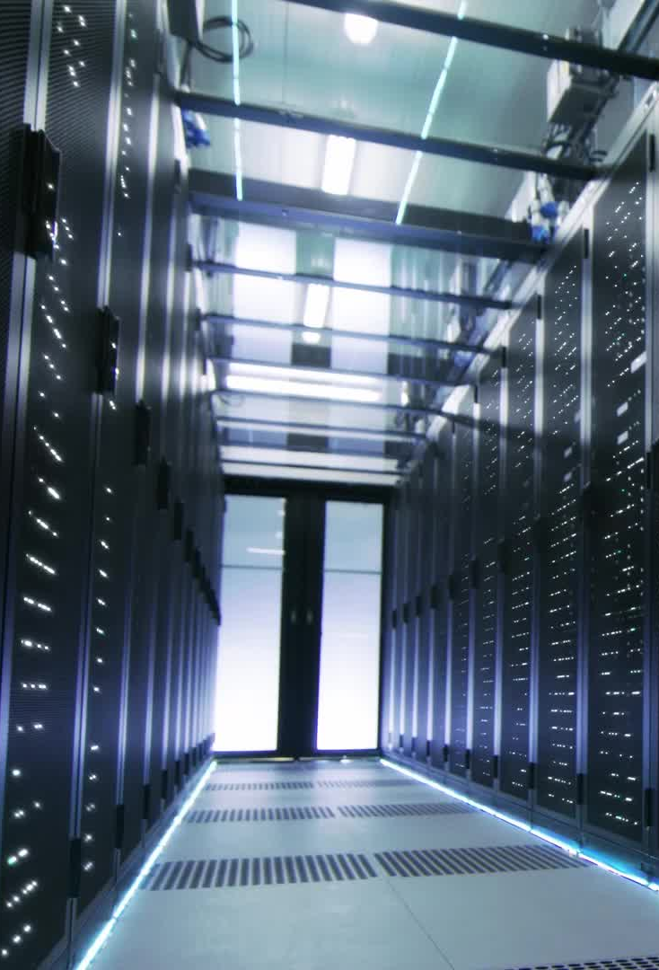
Business Problem
Challenges in Claim Processing:
Inconsistent Part Names: Different descriptions for the same part.
Data Standardization Issues: No unified system leads to delays.
Impact on Business:
Increased processing costs.
Higher fraud risks.
Reduced customer satisfaction.
Loss of competitive edge.

Slide 5
Key Risks
Data quality and standardization risks
Model performance risks
Operational and integration risks

Slide 6

Data description
Our data composed of three datasets: garage_data, surveyor_data, and Primary_Parts_Code.
The columns we mainly dealt with were part_description, txt_parts_name, surveyor_part_name, claimno.

Slide 7
Data Cleaning
Synonym replacement
Removal of stop words
Special character removal
Case standardization
Handling missing data

Slide 8

Proposed Approach
Hybrid approach using TF-IDF vectorization and Fuzzy String Matching to map parts between surveyor and garage datasets.

Slide 9
Key Steps in Approach
TF-IDF Vectorization
- Cosine Similarity Computation
- Identifying Best Matches
- Hybrid Matching with Fuzzy String Matching
- Exporting Results

Slide 10

Data Analysis
Analysis of the most ‘commonly damaged parts’ based on surveyor and garage datasets
Distribution of claims by primary parts
We mapped the surveyor_data and Primary_Parts_Code datasets to obtain the top 10 secondary parts associated with the primary part
Recommending associated damaged parts based on historical claim data

Slide 11
Associated damaged parts
Selected Parts | Recommended Parts
('windshield glass front') | [('moulding front windshield', 0.207), ('sealant front windshield glass 1', 0.103), ('head light right', 0.069), ('bonnet hood assembly', 0.034), ('cable comp hood latch release', 0.034)]
('windshield glass front', 'bumper front assembly') | [('sealant front windshield glass 1', 0.103), ('grille radiator lower', 0.093), ('fender panel front left', 0.037), ('brace, lamp support r', 0.037), ('bonnet hood assembly', 0.034)]
('head light right', 'grille radiator upper') | [('member lamp support rh', 0.167), ('member ho lock c', 0.167), ('carrier radiator support upper member r', 0.167), ('bumper absorber front r', 0.167), ('fog light front left', 0.167)]
('fender panel front right', 'bonnet hood assembly') | [('bonnet hood assembly', 0.095), ('hinge bonnet hood left', 0.095), ('fender panel front left', 0.071), ('member comp hood lock r', 0.048), ('hose discharge', 0.048)]
('brace', 'lamp support') | [('airbag dashboard passenger side', 0.5), ('bulb', 0.5), ('lamp support lh', 0.5), ('brkt radtr support r', 0.5), ('carrier radiator support lower member', 0.333)]

Slide 12
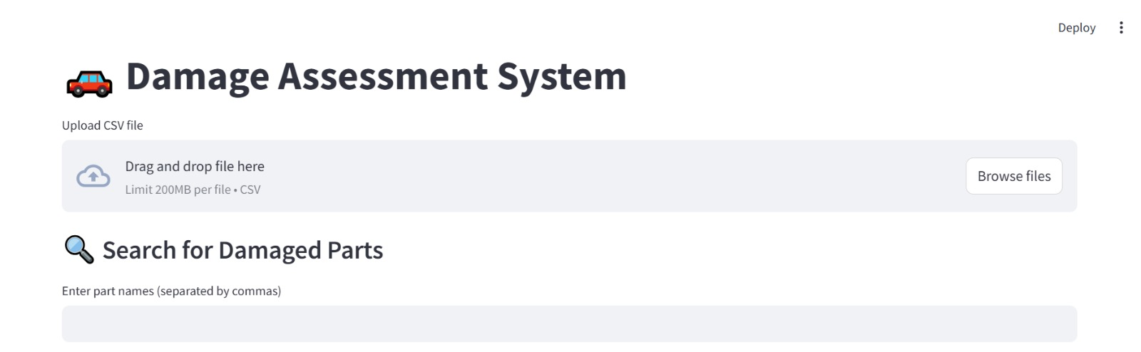
UI Integration – a few snippets
A Streamlit-based UI will be integrated with AutoSure Insurance’s claim management system for real-time mapping and recommendations.

Slide 13
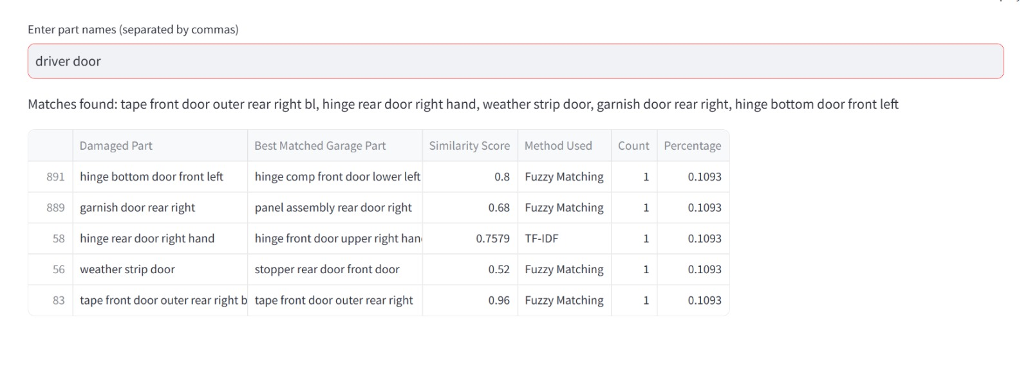
UI Integration – a few snippets

Slide 14
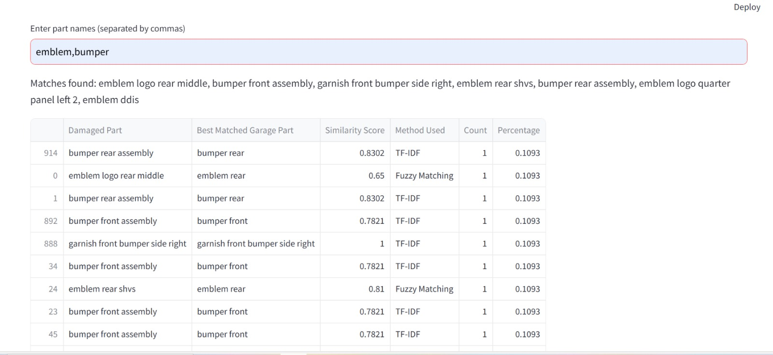
UI Integration – a few snippets

Slide 15
Conclusion
Faster and accurate claim processing
Improved fraud detection
Enhanced customer satisfaction
Seamless integration with existing systems

